Slide 1
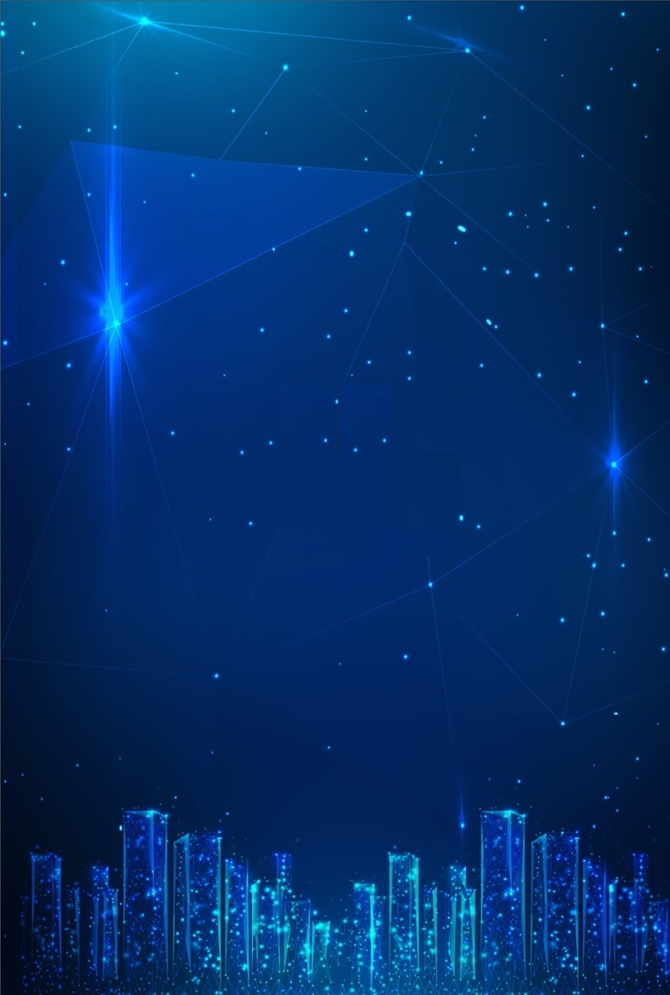


Seminar Announcement
DATE: 2024/12/17 (TUE.), 09:00-12:20
VENUE: Science Building3 Room353 (科學三館SC353)
Time | Speaker | Title of Talk
9:00-9:30 | Registration
9:30-10:20 | Prof. Jinke Tang | Investigation of Eu-based topological materials, 2M-WS₂ topological superconductor, and thermal (Hall) transport
10:20-11:10 | Prof. Yu-Tsung Tsai | Light-matter interaction of 2D vdWs lateral heterostructures and ferroic domains probed by laser-based microscopic techniques
11:10-11:30 | Break
11:30-12:20 | Prof. Chen-Ting Liao | Topologies in light & magnets: probing spin textures and optical phase structures
12:30-14:30 | Lunch
電子物理系 Department of Electrophysics

Slide 2
Seminar Announcement
DATE: 2024/12/17 (TUE.), 09:00-12:20
VENUE: Science Building3 Room353 (科學三館SC353)
Investigation of Eu-based topological materials, 2M-WS2 topological superconductor, and thermal (Hall) transport
09:30-10:20 Prof. Jinke Tang, University of Wyoming
In recent years EuAl4 has garnered intense interest due to the debated existence of two distinct low-temperature skyrmion lattices. We observed distinct magnetic phases within the proposed skyrmion pockets that have been reported in small angle neutron scattering. We also observed changes to the known charge density wave (CDW) phase below approximately 144 K. We explored the evolution of these two magnetic phases as a function of Gd-doping, up to approximately 13% Gd concentration. A noticeable shift in the critical DC magnetic field at which those two magnetic phases manifest and dissipate can be seen as the percentage of Gd dopant increases. We also report a distinct difference in the response of the proposed rhombic skyrmion lattice at higher excitation frequencies in the AC susceptibility as compared to the response of the proposed square skyrmion lattice at frequencies below 500 Hz. We also explored the effects on the CDW Tc as a function of Gd concentration using heat capacity measurements.
We probe thermal properties of monoclinic tungsten disulfide (2M-WS2) single crystals as a function of temperature to pair with pre-existing data showing superconductivity in 2M-WS2 to further enhance our understanding of this topological superconducting material and its unique properties. We plan to investigate thermal Hall effect using a device constructed for 2M-WS2 thin films, where Majorana particles are theorized to exist, and other topological materials. The device will be constructed using electron beam lithography (EBL).
Light-matter interaction of 2D vdWs lateral heterostructures and ferroic domains probed by laser-based microscopic techniques
10:20-11:10 Prof. Yu-Tsung Tsai, University of Wyoming
Various two-dimensional (2D) functionalities have been observed in van der Waals (vdW) materials, such as superconductivity, ferromagnetism, ferroelectricity, and antiferroelectricity, expanding the potential for creating ultrathin, flexible 2D heterostructure devices. Among these 2D materials, both 2D semiconductors (WS2, WSe2, MoS2, MoSe2) and 2D layered ferroelastic (FE) materials (WO2I2, NbOI2) have attracted tremendous research interests. For 2D semiconductors, they have superior advantages of electrical tunability of Fermi levels, intrinsic compatibility to the fabrication of planar devices, and moderate requirements of the lattice match for heterostructure integration. Among the ferroic properties, ferroelasticity stands out as the mechanical counterpart to ferromagnetism and ferroelectricity. It involves the switching of spontaneous lattice strain across multiple orientation states when subjected to mechanical stimuli. Ferroelasticity underlies phenomena like the shape-memory effect and superelasticity, making it crucial for applications in piezoelectric sensors, mechanical switches, and actuators. However, to probe 2D lateral heterostructures such as 2D semiconductor lateral multijunctions and natural layered 2D vdWs FE lateral domains in WO2I2 require laser-based microscopic techniques for spatial resolution. In this talk, photon-assisted microwave microscopy, Angle-resolved (AR)/helicity-resolved (HR) Raman microscopy, and ultra-fast pump-probe microscopy (UPPM) will be discussed along with three research results: a) 2D lateral WS2-W(S1-xSex)2-WS2 multijunction with 100-fold photoconductivity, b) 2D lateral MoS2-MoS2/WS2-WS2 probed with UPPM for carry dynamics, and c) layered WO2I2 single crystal with FE lateral domains revealed by HR Raman microscopy. Last, I will introduce current status of 2D opTiclab in the University of Wyoming and its research focus moving forward after the arrival of 9 tesla optical cryostat, seeking collaboration with researchers here!
Topologies in light & magnets: probing spin textures and optical phase structures
11:30-12:20 Prof. Chen-Ting Liao, Indiana University (IU) Bloomington
Symmetry breakings are ubiquitous in nature and can lead to the formation of various topological states and excitations, such as those in ferromagnetism, molecular chirality, optical activity, and vortex beams carrying orbital angular momentum (OAM). In the first part of my talk, I will show how a new coherent diffractive imaging technique, called vector ptychographic tomography, which uses coherent extreme UV or soft x-ray beams, can probe chemically resolved nanostructures in semiconductor materials1 and spin textures in magnetic materials. This lensless computational imaging method provides 2D/3D vector imaging with a resolution of 5-10 nm2, leading to our direct observation of topological magnetic monopoles and their interactions3. Next, I will introduce topological states of light carrying OAM, which can be static, attosecond-to-femtosecond dynamic4, spin-orbit coupled5, or spatiotemporally coupled6,7 (a subset of space-time optics family8). OAM of light can span the infrared to extreme UV spectra when up-converted and controlled through a laser-driven high-order harmonic generation process4,5 (the process recognized by the 2023 Nobel Prize in Physics). OAM of light and the new space-time optics promise novel and under-exploited applications in communications, sensing, imaging, and controlling topological spin textures in the near future.

